Slide 1

PERSONALIZED ACADEMIC INTERVENTIONS
USING ADAPTIVE AND EXPLAINABLE AI: MULTI-
MODAL LEARNING ANALYTICS FRAMEWORK
Final Year Project Proposal Presentation
Project ID - 25-26J-172
Team Members
Ravisanka U V P - IT22354792 (Component 01)
Disanayaka S T - IT22370228 (Component 02)
Nimanji D.L.K - IT22365750 (Component 03)
Perera I A T D - IT22902702 (Component 04)
9/11/2025
1

Slide 2
Overview
This research presents a multi-component AI framework designed to enhance student success by providing personalized academic interventions. Each component addresses distinct yet interconnected challenges, leveraging adaptive machine learning, explainability, secure analytics, and engagement detection to form a comprehensive support system for learners.
Component 01 - Adaptive Penalty-Augmented Ensemble Machine Learning Engine
Real-time student risk scoring. It dynamically adjusts model contributions to improve prediction accuracy from diverse educational data.
Component 02 - Explainable AI Engine that generates interpretable student risk insights
Real-time student risk scoring. It dynamically adjusts model contributions to improve prediction accuracy from diverse educational data.
Component 03 - Secure Analytics & Performance Optimization Platform
Real-time student risk scoring. It dynamically adjusts model contributions to improve prediction accuracy from diverse educational data.
Component 04 - Student Disengagement Detection and Personalized Support System
Real-time student risk scoring. It dynamically adjusts model contributions to improve prediction accuracy from diverse educational data.
9/11/2025
2

Slide 3
Introduction to the Problem
Despite advances in educational technology, many institutions struggle to identify at-risk or disengaged students early enough to intervene effectively. Existing solutions often lack adaptability, transparency, data security, or real-time capabilities, resulting in delayed action and insufficient personalized support. Our framework addresses these gaps through integrated, adaptive, explainable, and secure AI-driven components.
Overarching Research Questions
How can real-time, adaptive machine learning models improve accuracy in predicting student academic risks?
How to design a secure and scalable analytics system that protects sensitive student data?
What methods effectively detect student disengagement and provide personalized, timely support to reduce dropout rates?
9/11/2025
3

Slide 4
Social & Research Impact
Empower educators with timely, reliable insights to deliver personalized interventions, promoting student retention and success.
Advance educational AI research by integrating adaptive learning, explainability, and data security in large-scale, real-time systems.
Contribute to equitable education by addressing diverse learner needs early, minimizing dropout rates, and supporting mental well-being.
Create a replicable framework adaptable to various educational settings globally.
Constraints, Limitations
Availability and quality of comprehensive multi-modal data.
Computational overhead of real-time processing at scale.
Ensuring privacy compliance while maximizing data utility.
Potential delays in intervention effectiveness due to external factors.
9/11/2025
4

Slide 5
Previous Research Shortcomings
Limited Adaptability
Partial Data Utilization
Lack of Explainability and Trust
Insufficient Real-Time Capability
Data Privacy and Security Gaps
Limited Engagement Detection
Our Approach
Adaptive Penalty-Augmented Ensemble Learning
Comprehensive Multi-Modal Data Fusion
Explainable AI Integration
Real-Time Processing Framework
Secure and Optimized Analytics Platform
Proactive Disengagement Detection Module
9/11/2025
5

Slide 6
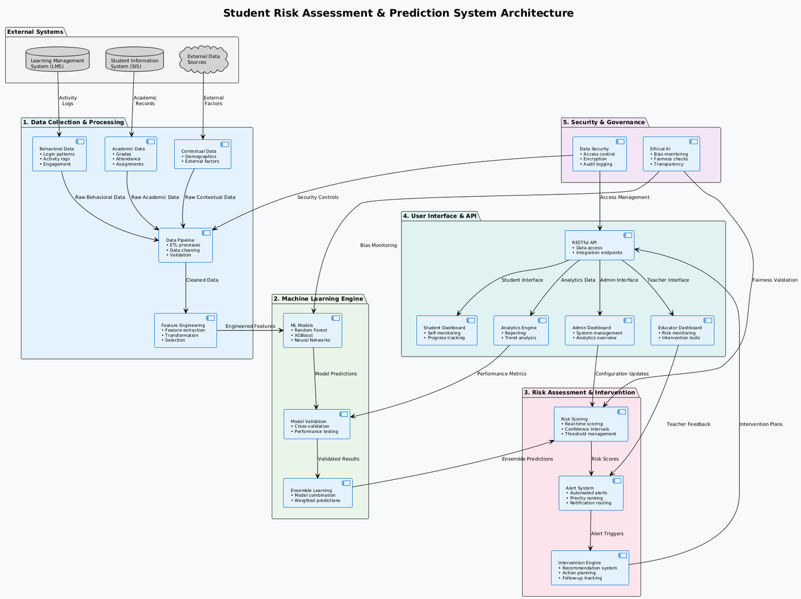
System Diagram
9/11/2025
6

Slide 7


DESIGN AND DEVELOPMENT OF AN ADAPTIVE PENALTY-AUGMENTED ENSEMBLE MACHINE LEARNING ENGINE FOR REAL-TIME STUDENT RISK SCORING AND PREDICTION
Specialization: Information Technology
IT22354792 |
Ravisanka U V P
25-26J-172
9/11/2025
7

Slide 8
Design and Development of an Adaptive Penalty-Augmented Ensemble Machine Learning Engine for Real-Time Student Risk Scoring and Prediction
Proven Gap & Problem Definition
Lack of real-time, accurate student risk scoring using adaptive ensemble learning.
Existing systems limited by single-model methods and low interpretability.
Existing predictive models often fail to capture early signs of student disengagement.
Traditional models often rely on batch processing, limiting their ability to provide timely predictions.
Proposed Solution
Adaptive penalty-augmented ensemble engine integrating multi-modal data.
Combining academic, behavioral, and psychological data streams to enrich feature spaces.
Data Imbalance and Quality Management with noice filtering to improve quality on real-world datasets.
Real-Time Risk Scoring with Streaming Architecture
IT22354792 |
Ravisanka U V P
25-26J-172
9/11/2025
8

Slide 9
Design and Development of an Adaptive Penalty-Augmented Ensemble Machine Learning Engine for Real-Time Student Risk Scoring and Prediction
Key Domains of Specialization
Educational Data Mining: Techniques such as effective extraction, cleaning, and feature engineering from diverse educational datasets, including academic performance, attendance records, and behavioral logs.
Advanced Machine Learning & Ensemble Methods: The function centers on ensemble machine learning, combining multiple base models to improve predictive accuracy and robustness.
Real-Time Data Processing & Streaming: Supporting continuous, timely risk assessment requires expertise in streaming data frameworks
Behavioral and Psychological Analytics: Incorporation of behavioral patterns and psychological indicators into the model necessitates domain knowledge in these areas to ensure meaningful data representation and integration alongside traditional academic data for holistic risk assessment.
Latest Technologies Utilized
Adaptive Penalty-Augmented Ensemble Learning
Multi-Modal Data Integration Methods
Streaming Platforms for Real-Time Processing
Data Quality and Imbalance Handling Methods
Data Anonymization and Privacy Preservation
IT22354792 |
Ravisanka U V P
25-26J-172
9/11/2025
9

Slide 10
Design and Development of an Adaptive Penalty-Augmented Ensemble Machine Learning Engine for Real-Time Student Risk Scoring and Prediction
Evaluation & Validation Methods
Cross-Validation : Split data into multiple training and testing folds.
Temporal Validation : Train the model on data from earlier academic periods and validate on later periods to simulate real-world deployment.
Internal and External Validation : Use different datasets to validate whether the model generalizes beyond the original training data.
Bootstrapping : Resample the data with replacement multiple times to estimate the stability and variability.
Data Availability and Ethical Clearance
The function utilizes multi-source educational data including Academic records (grades, test scores), Attendance and punctuality logs, Behavioral surveys and psychological assessments.
Data collection and use are subject to equivalent ethics committee to uphold responsible research conduct.
Informed consent is obtained from students and/or guardians, ensuring participants understand data usage and privacy rights.
Sensitive data is encrypted in storage and during transmission.
Compliance with regional and international legal frameworks such as GDPR (General Data Protection Regulation)
IT22354792 |
Ravisanka U V P
25-26J-172
9/11/2025
10

Slide 11
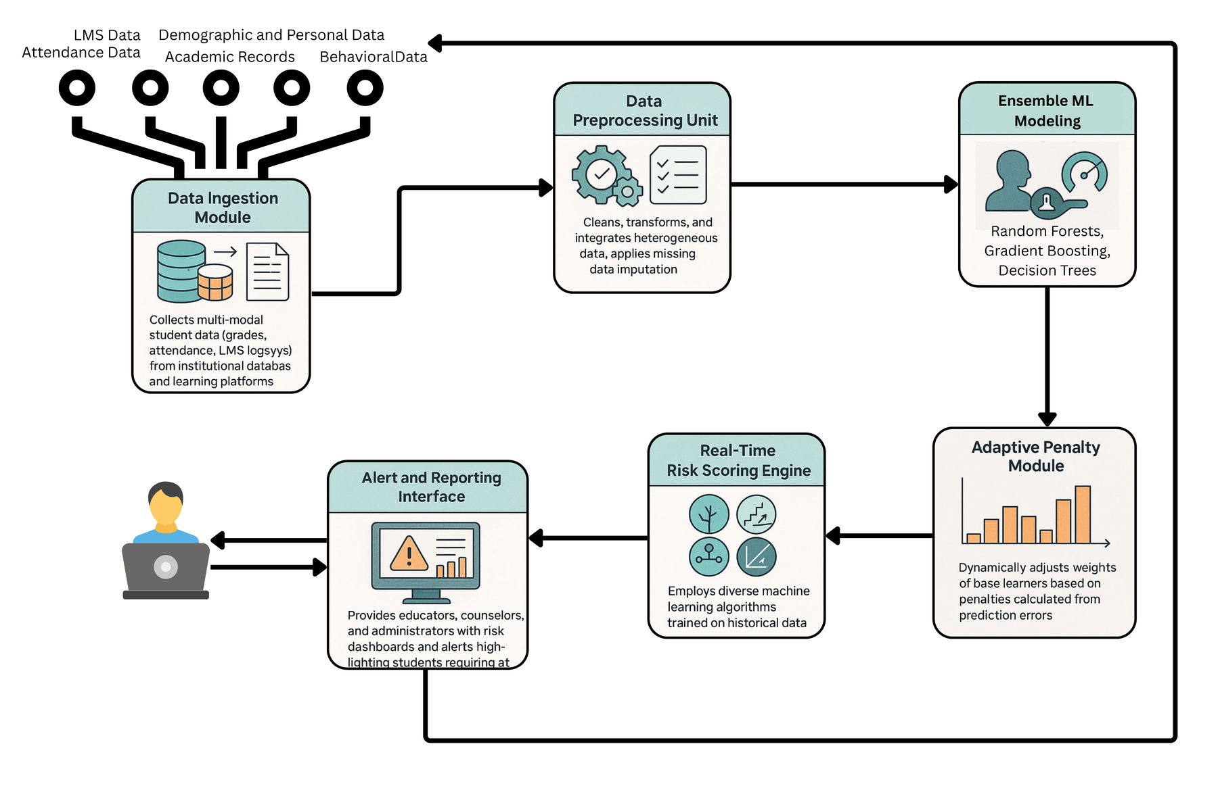
Design and Development of an Adaptive Penalty-Augmented Ensemble Machine Learning Engine for Real-Time Student Risk Scoring and Prediction
System Overview
Data Ingestion Module
Data Preprocessing Unit
Ensemble ML Modeling
Adaptive Penalty Module
Real-Time Risk Scoring Engine
Reporting Dashboard Interface
Real-World Scenario
The system is integrated with the institution’s Student Information System (SIS) and Learning Management System (LMS) to access live and historical data seamlessly
As new data is captured the engine processes these inputs in real-time, updating risk scores dynamically.
Educators and students receive updated risk scores via dashboards, allowing them to prioritize interventions for students identified as high risk.
Outcomes of interventions and new data feed back into the system, allowing the model to adjust penalty weights and improve future predictions continuously.
Aggregate reports help decision-makers understand risk trends.
IT22354792 |
Ravisanka U V P
25-26J-172
9/11/2025
11

Slide 12

DESIGN AND DEVELOPMENT OF AN EXPLAINABLE AI ENGINE FOR STUDENT RISK INSIGHTS AND RECOMMENDATIONS
Specialization: Information Technology
IT22370228 |
Disanayaka S.T
25-26J-172
8/26/2025
12

Slide 13
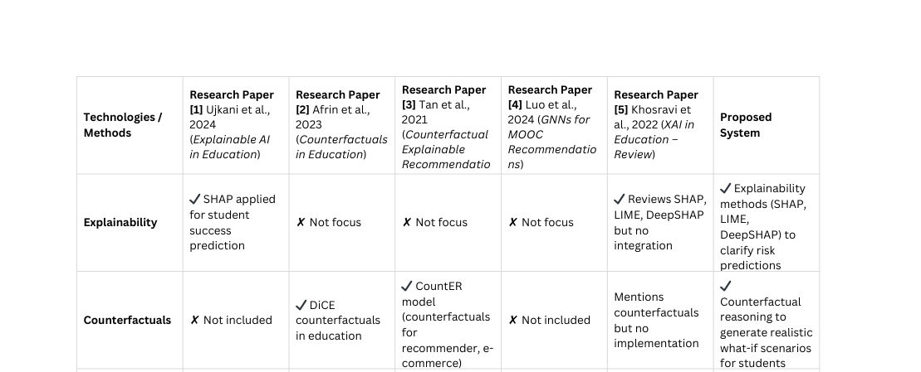
DESIGN AND DEVELOPMENT OF AN EXPLAINABLE AI ENGINE FOR STUDENT RISK INSIGHTS AND RECOMMENDATIONS
Knowledge Gap
Shortcomings of Existing Systems and Proposed Solution
Current student risk prediction systems act as black boxes, providing only scores without explanation.
Few systems provide counterfactual “what-if” scenarios, and when they do, they are often unrealistic or limited to other domains.
Existing educational recommenders focus on courses or content, not personalized interventions for at-risk students.
None of the existing systems integrate a feedback loop — they don’t learn from whether an intervention worked or failed, meaning recommendations remain static.
Fairness and bias mitigation are rarely addressed in education AI systems.
No unified framework combines prediction, explainability, counterfactuals, adaptive recommendations, fairness, and usability.
Creative Solution
Integrated Framework: Combines explainability, counterfactual reasoning, personalized recommendations, fairness validation, and a user-friendly dashboard.
Counterfactual Generator (GANs/VAEs): Creates realistic “what-if” scenarios → actionable guidance.
Feedback-Enhanced Recommendation ModelModel (GNNs/Transformers)Personalized interventions (tutoring, mentoring, attendance programs) adapt over time.Feedback loop ensures the system learns from real-world outcomes, making recommendations increasingly accurate and context-sensitive—a feature largely missing in existing solutions.
Interactive Dashboard: Visual + natural-language outputs for intuitive understanding.
IT22370228 |
Disanayaka S.T
25-26J-172
8/26/2025
13

Slide 14
Design and Development of an Explainable AI Engine for Student Risk Insights and Recommendations
Key Domains of specialization
Technologies Used
Machine Learning (ML): predictive modeling and classification.
Explainable AI (XAI): SHAP, LIME, DeepSHAP for transparency.
Counterfactual Reasoning: generative models (GANs/VAEs) for realistic what-if scenarios.
Recommender Systems: advanced recommendation with Graph Neural Networks (GNNs) / Transformers.
Human-Computer Interaction (HCI): intuitive dashboard design and visualization.
ML Models: Random Forest and XGBoost for student risk prediction.
Explainability: SHAP, LIME, DeepSHAP.
CounterfactualGeneration: GANs / VAEs for natural, realistic what-if profiles.
Recommendation: GNNs or Transformer-based recommenders for complex relationship
Validation Strategy
Data Availability and Ethical Clearance
Accuracy ≥ 90% with precision/recall metrics.
Fairness checks: ensure no bias across gender or background groups.
A/B testing with teachers and students for usability feedback.
Anonymized student datasets.
follows GDPR-compliant handling of sensitive educational data.
IT22370228 |
Disanayaka S.T
25-26J-172
8/26/2025
14

Slide 15
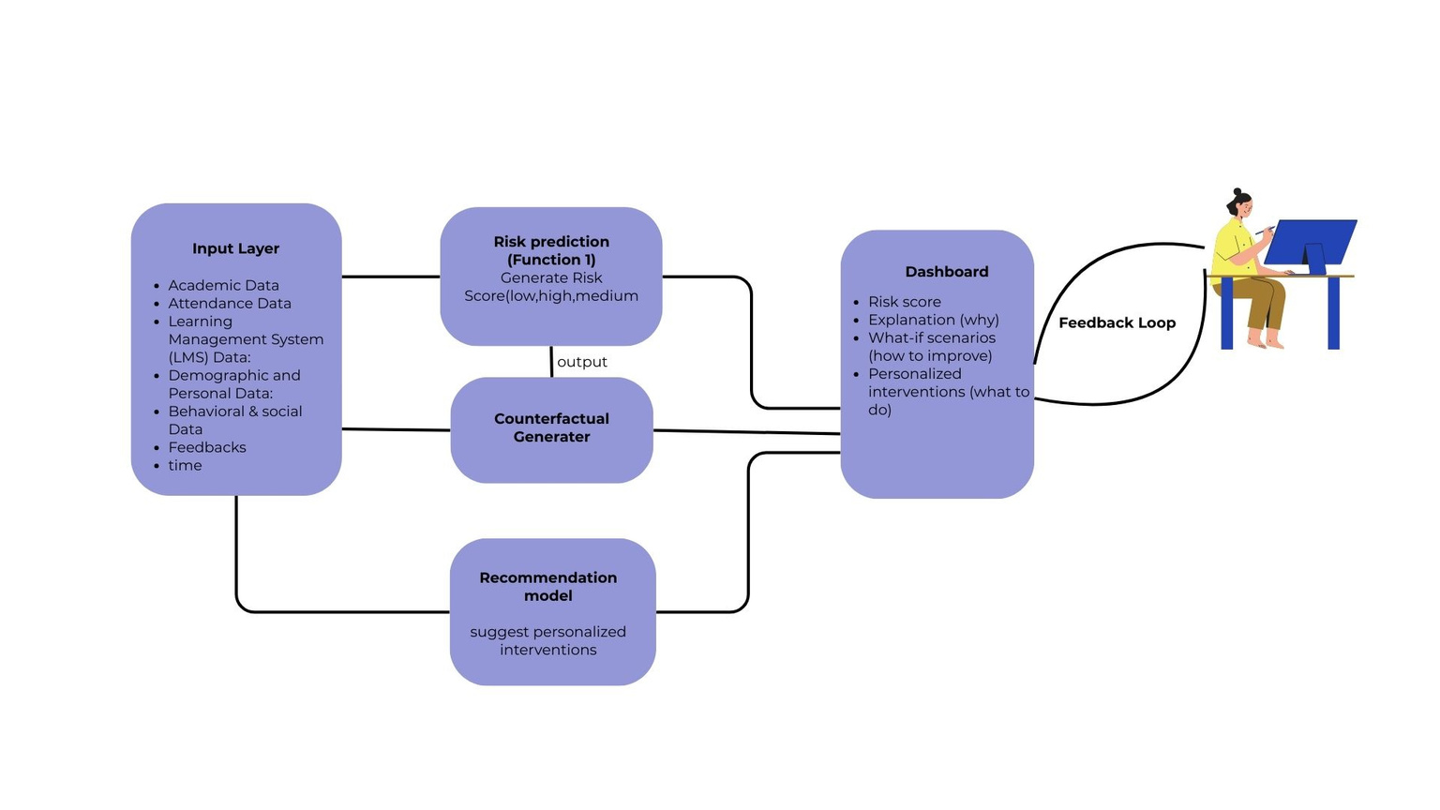
Design and Development of an Explainable AI Engine for Student Risk Insights and Recommendations
Real-world scenario
lectuers: view why a student is at risk + suggested interventions.
Students: explore “what-if” scenarios (e.g., improving attendance, submitting more assignments).
Both: use recommendations for early, targeted interventions.
Supports reducing dropout risk through clear, actionable guidance.
IT22370228 |
Disanayaka S.T
25-26J-172
8/26/2025
15

Slide 16

SECURE ANALYTICS & PERFORMANCE OPTIMIZATION PLATFORM
Specialization: Information Technology
IT22365750 |
Nimanji D.L.K |
25-26J-172
16

Slide 17
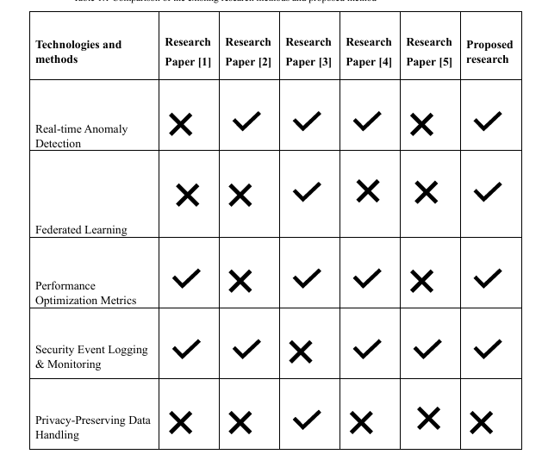

SECURE ANALYTICS & PERFORMANCE OPTIMIZATION PLATFORM
SHORTCOMINGS OF EXISTING SYSTEMS
Knowledge Gap
Existing learning analytics platforms mainly focus on student outcomes, but ignore system performance and security risks.
No real-time monitoring of anomalies such as suspicious logins, errors, or performance bottlenecks.
Creative Solution
Introduce a secure analytics and optimization platform that continuously monitors performance, detects anomalies, and generates actionable insights for administrators.
IT22365750 |
Nimanji D.L.K |
25-26J-172
17

Slide 18



SECURE ANALYTICS & PERFORMANCE OPTIMIZATION PLATFORM
What specific Latest Technology
Key Domains of specialization
ML for Anomaly Detection → Isolation Forest, Autoencoders (Scikit-learn, TensorFlow, PyTorch)
Federated Learning → TensorFlow Federated, PySyft (privacy-preserving collaboration)
Secure Access → JWT authentication + AES-256 encryption + HTTPS/TLS
Real-Time Dashboard → React.js + Tailwind CSS + Plotly/Chart.js (for live metrics & alerts)
Database & Cloud → Firebase Firestore (NoSQL, real-time) + Firebase Hosting / AWS
Machine Learning – anomaly detection (Isolation Forest, Autoencoders).
Cybersecurity – encryption, federated learning, secure authentication.
Cloud Computing & Analytics – scalable data collection and visualization dashboards.
How to Evaluate
Data Availability and Ethical Clearance
Measure anomaly detection accuracy.
Test system response time improvements.
User feedback from administrators on dashboard usability.
Use system log datasets and synthetic student activity logs.
Ensure data privacy with encryption and federated learning.
Align with GDPR / FERPA compliance.
IT22365750 |
Nimanji D.L.K |
25-26J-172
18

Slide 19

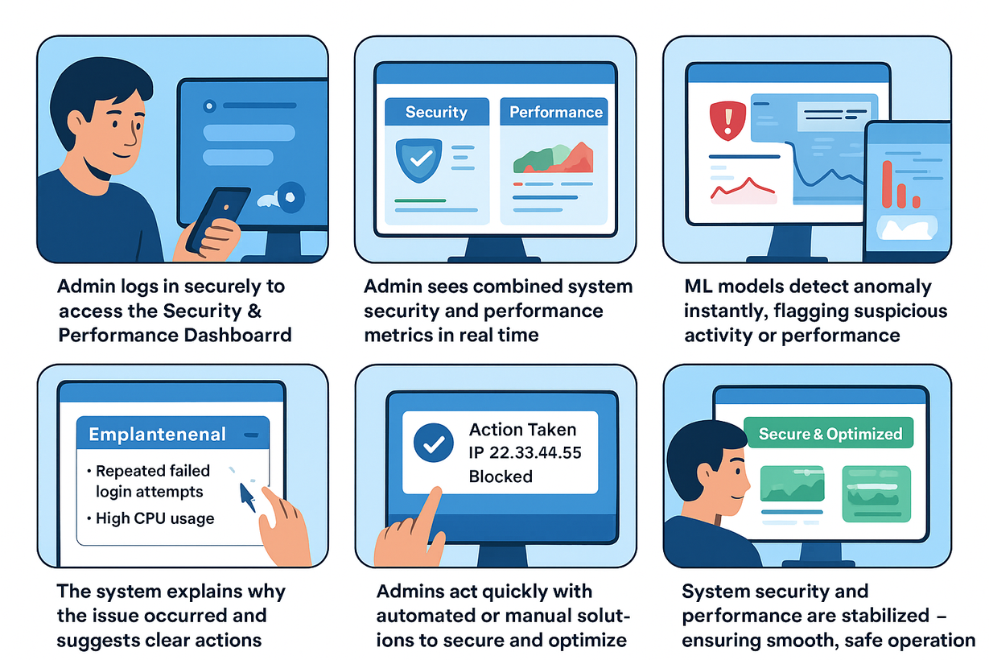
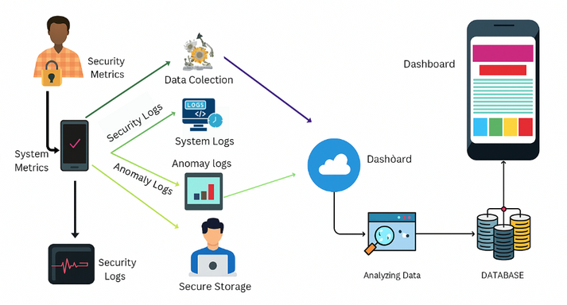
SECURE ANALYTICS & PERFORMANCE OPTIMIZATION PLATFORM
Real-world scenario
System Overview
IT22365750 |
Nimanji D.L.K |
25-26J-172
19

Slide 20

STUDENT DISENGAGEMENT DETECTION AND PERSONALIZED SUPPORT SYSTEM FOR RE-ENGAGEMENT AND REDUCING DROPOUT RISK
Specialization: Information Technology
IT22902702 |
Perera I.A.T.D |
25-26J-172
20

Slide 21

STUDENT DISENGAGEMENT DETECTION AND PERSONALIZED SUPPORT SYSTEM FOR RE ENGAGEMENT AND REDUCING DROPOUT RISK
Knowledge Gap
Current systems usually notice students only after they are already disengaged - by then, it’s too late to help effectively.
Current systems send generic support messages - the same reminder for every student, without considering individual needs.
Most importantly, they stop at this stage and don’t take further action to actively re-engage the student.
Creative Solution
Predict early warning signs of disengagement before students completely drop off.
Deliver personalized, adaptive support based on student behavior and feedbacks.
Use emotion checks and progress tracking to confirm genuine re-engagement, with escalation to human support when necessary.
IT22902702 |
Perera I.A.T.D |
25-26J-172
21

Slide 22


STUDENT DISENGAGEMENT DETECTION AND PERSONALIZED SUPPORT SYSTEM FOR RE ENGAGEMENT AND REDUCING DROPOUT RISK
Key Domains of specialization
Machine Learning – to predicts students disengagemet based on activity patterns.
Reinforcement Learning – to send adaptive interventions to actively re-engage students
Sentiment Analysis .
What specific Latest Technology
Sequential Prediction Models – Gated Recurrent Unit (GRU) / Long Short-Term Memory (LSTM):
- Identify patterns in student activity over time and predict disengagement before it happens.
Reinforcement Learning Strategies – Q-Learning / Deep Q-Networks (DQN):
- Test different re-engagement approaches and learn which ones work best for each student.
Emotion Detection APIs – Google Cloud Natural Language, TextBlob, Hugging Face Transformers:
-Analyze student replies or survey feedback to recognize emotions such as stress, confusion, or motivation
Real-Time Messaging – Firebase Cloud Messaging (FCM), WebSocket:
-Deliver alerts instantly and collect student feedback in real time.
IT22902702 |
Perera I.A.T.D |
25-26J-172
22

Slide 23
STUDENT DISENGAGEMENT DETECTION AND PERSONALIZED SUPPORT SYSTEM FOR RE ENGAGEMENT AND REDUCING DROPOUT RISK
How to Evaluate/Prove the Success
Prediction Accuracy → target 80–85% in identifying at-risk students before disengagement happens.
Re-engagement Tracking → measure if students return, spend more time, or improve task completion.
Emotion-aware validation → check if interventions adapted to stress/confusion increase response rates.
Continuous Monitoring → track progress to confirm students remain engaged, not just temporarily.
Data Availability and Ethical Clearance
Data Sources
LMS activity logs → logins, study session duration, task completion.
Alert/notification responses → whether students open or ignore them.
Short survey or feedback texts → for emotion detection.
Escalation to Human Support
If emotion analysis shows signs of high stress or serious issues, the case is safely referred to teachers or counselors for personal support.
IT22902702 |
Perera I.A.T.D |
25-26J-172
23

Slide 24













STUDENT DISENGAGEMENT DETECTION AND PERSONALIZED SUPPORT SYSTEM FOR RE ENGAGEMENT AND REDUCING DROPOUT RISK
System Overview
Real-world scenario
User Interfase
Students get reminders and guidance when their activity drops.
Quick surveys check stress levels through simple responses
The system adapts messages based on student behavior.
Serious cases are flagged and sent to staff for support
Inputs
Activity Logs
risked students
Survey Results
responses
Data Preparation
DataBase
Disengagement
Model
RL Model
Mood analysis
Outputs
Guidance
Notification
predictions
IT22902702 |
Perera I.A.T.D |
25-26J-172
24

Slide 25
PERSONALIZED ACADEMIC INTERVENTIONS USING ADAPTIVE AND EXPLAINABLE AI: MULTI- MODAL LEARNING ANALYTICS FRAMEWORK
Investment / Cost
Developement: 1,000,000 LKR annually for machine learning, AI and implementation.
Infrastructure: With government “Cloud First” policy promoting cloud adoption (Apache Kafka, AWS, Azure) estimated at roughly 20,000 to 40,000 LKR/month for compute and storage at startup scale.
Cost Recovery
Subscription model targeting educational institutions charging 1500 LKR per student
Customization and training packages billed separately, e.g., 500,000–1,000,000 LKR per contract.
Government grants and educational funding programs may subsidize early adoption.
Potential to scale with private university and vocational sector clients at premium pricing.
Target Market
Sri Lanka has over 4.5 million students enrolled in Government and private schools.
Growing market focus on Higher Education with 23% tertiary enrollment.
Customer Profiles
Public and private universities, schools, technical/vocational institutes.
Government education departments and school management bodies.
NGOs and international development agencies engaged in education improvement.
8/26/2025
25

Slide 26
Thank You
8/26/2025
26

